Slide 1






Yousef Adham Mahmoud
Data analysis of a heart disease’s data sheet
A look at the different factors causing heart diseases and the correlation between each factor

Slide 2



Agenda
WHAT I WILL DISCUSS IN THIS PRESNTATION:
General information and simple explanation of the data
Asking multiple questions about the data, viewing their answers and conveying my insights
Displaying the algorithm that finds out if a person has a heart disease, and commenting about its accuracy.
Finally, we will end with your questions.

Slide 3


What is the data that I have analyzed?
What is the data that I have analyzed?
What could a heart disease data sheet be composed of?
The columns’ names:

Slide 4

The general health of people as they age.

Slide 5
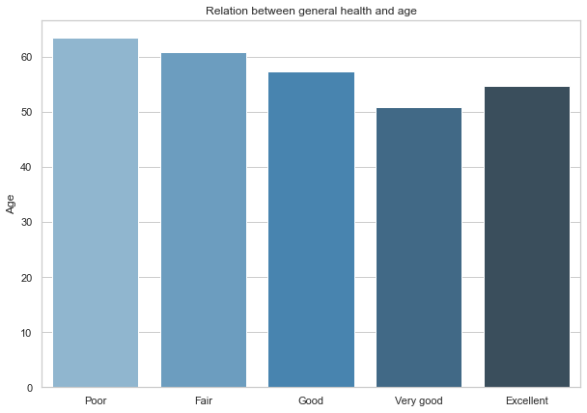
The general health of people as they age
My insights:
As expected, most people report experiencing worse general health as they age, but surprisingly 50 year old people report having worse general health than 55 year old people

Slide 6

Does smoking raise the chances of experiencing heart diseases?
Scientific research proves that:
Cigarette smokers are 2 to 4 times more likely to get heart disease than nonsmokers.

Slide 7



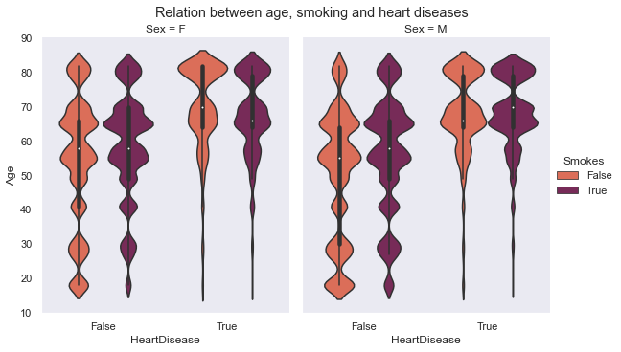
Relation between age, smoking and heart diseases
Smoking does increase the risk of getting a heart disease
Age plays a bigger role on the chances of getting a heart disease
Males are more likely to get heart disease than females

Slide 8
Alcohol consumption and its relation to heart disease.
Scientific studies prove that:
Excessive alcohol intake can lead to high blood pressure, heart failure, stroke, or cardiomyopathy.

Slide 9
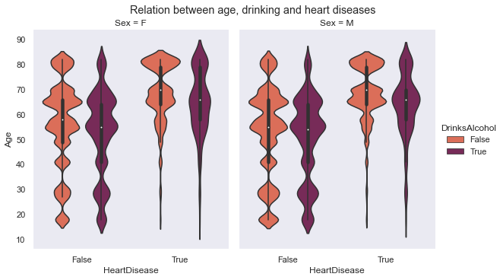
Relation between age, consuming alcohol and heart diseases
Alcohol consumption seems to have a bigger impact on the chance of getting a heart disease, as compared to smoking.
Age plays a bigger role on the chances of getting a heart disease
Males are more likely to get heart disease than females

Slide 10




Is there a relation between physical activity, physical health, heart disease and age?

Slide 11
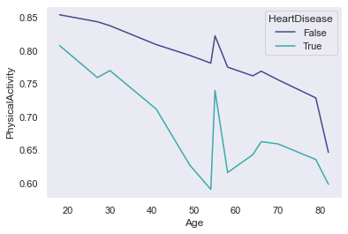
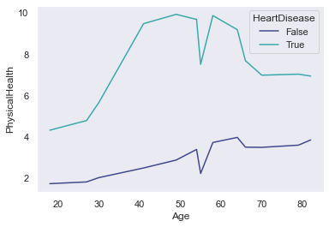
Physical health & physical activity relation with age and heart disease
My insights:
As expected, most people report having less physical activity as they get older, and the cardiac patients report even less activity. But, surprisingly cardiac patients report having better overall physical health , compared to healthy subjects.

Slide 12
Do different races have different chances of getting heart diseases?
First we’ll take a look at the average BMI of each race
Then we’ll discuss the occurrences of heart disease in each race

Slide 13
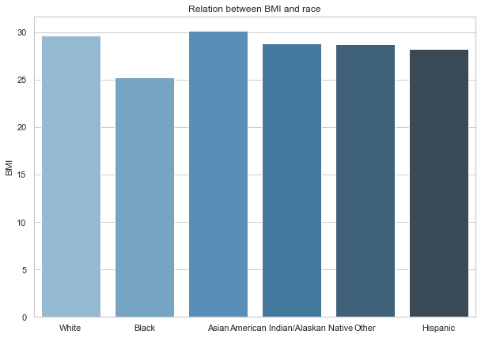
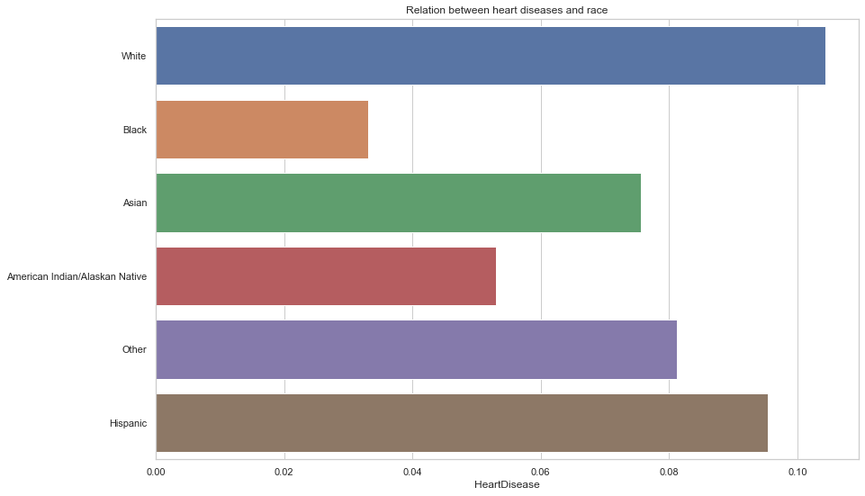
BMI, race & heart disease occurrence
Insights:
They all average out to approximately the same BMI, but Blacks seem to average out a bit lower.
Whites and Hispanics are the top place holders on races that experience heart disease.

Slide 14
Is there a relation between diabetes, and heart diseases? Or strokes and heart diseases?

Slide 15
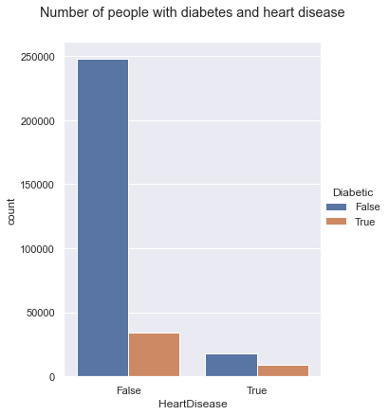
Relation between diabetes, and heart diseases
The majority of diabetic patients aren’t cardiac patients
Almost half of cardiac patients are diabetic patients

Slide 16
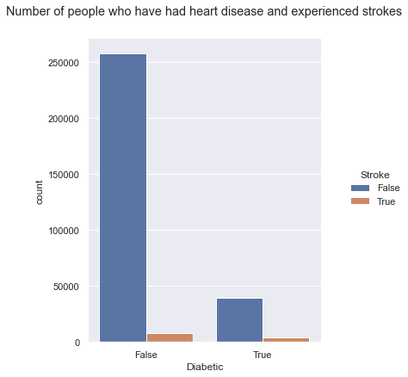
Relation between strokes, and heart diseases
As a percentage of the total value, healthy patients are much less likely to experience strokes as compared to cardiac patients

Slide 17
Does reduced sleep time increase the risk of having a stroke?

Slide 18
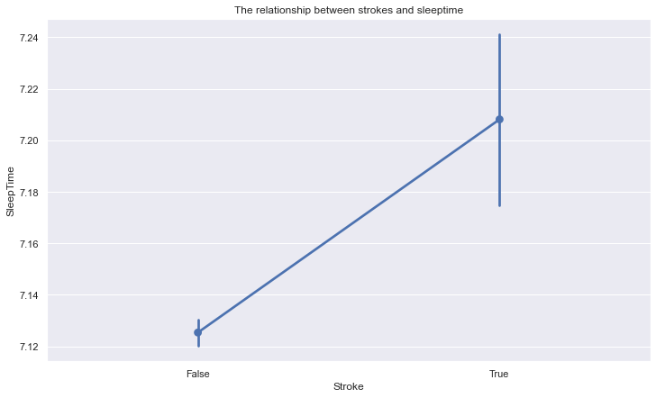
Strokes and sleep time relation
My insights:
Strokes and sleep times are vaguely related and shouldn’t be taken into any medical consideration

Slide 19

The prediction algorithm
After trying three different models for predicting whether or not the person has a heart disease I found out that the random forest tree is the most suitable and precise model

Slide 20
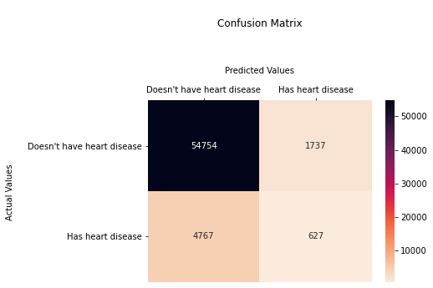
The model’s prediction results
Accuracy:90%

Slide 21

Do you have any questions?

Slide 22
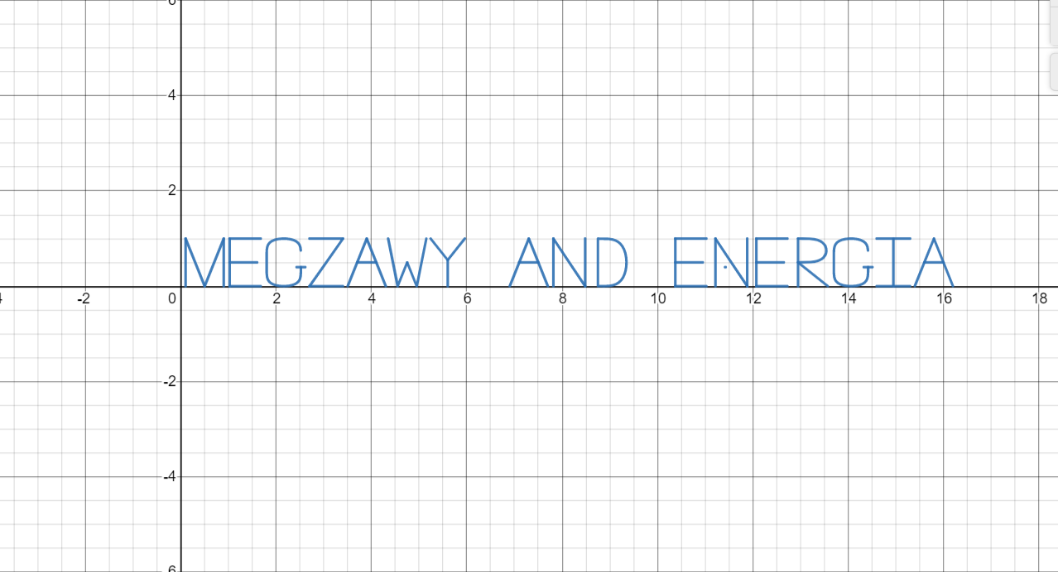
Special thanks to:

Slide 23






























Free Resources
Use these free recolorable icons and illustrations in
your Canva design

